Slide 1
Course: MOBI8001 - Mobile Technology and Cloud Computing
Period: March 2017
Mobile Social Cloud Computing
Session 10
D5627 – I Gede Putra Kusuma Negara, B.Eng., PhD

Slide 2
Outline
Introduction
Mobile Social Cloud Architecture
Resource Sharing in Mobile Social Cloud
Warehousing and Analyzing Social Data Using Cloud
Social Compute Cloud: Sharing and Allocating Resources
3D Visualization of Social Network Data
Applications of Mobile Social Cloud
Conclusion
Bina Nusantara University

Slide 3
Introduction
Social networking is an online service by which many people who are members of the same social networking application can communicate with each other.
The sensing, analyzing, and storing of a large amount of social data have become a very important issue.
Social sensors are effective human–device combinations that send torrents of data as a result of social interactions and events.
Cloud can be the finest solution to analyze, cluster, store, and compute the data.
Social cloud is a combination of social networking and cloud.
Massive use of mobile technologies such as laptops and smartphones is also drawing attention toward the cloud for processing power, storage space, and energy saving, which in turn leads to a new concept known as “mobile social cloud.”
Bina Nusantara University

Slide 4
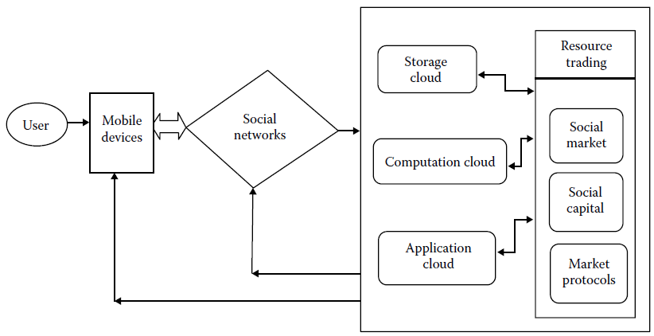
Mobile Social Cloud Architecture
Architecture of mobile social cloud:
Bina Nusantara University

Slide 5
Mobile Social Cloud Architecture
Modules of mobile social cloud:
  User: the social network user who accesses social networking sites through mobile devices.
  Mobile devices: laptops, smartphones, iPads, iPhones, etc.
  Social networks: an implementation of a general network in which each node indicates a user and the edges indicate connection between them.
  Cloud: a combination of virtualization of a large amount of resources with a distributed computing paradigm incorporated with SaaS, PaaS, and IaaS.
Bina Nusantara University

Slide 6
Mobile Social Cloud Architecture
The cloud module contains three sub-modules:
  Storage: the social data are stored inside the cloud. As social networks generate tremendous amounts of data, it is not feasible to store them without cloud.
  Computation: the computations of data analysis are performed inside the cloud.
  Application: various social applications such as Facebook and Twitter apps run on the cloud.
Bina Nusantara University

Slide 7
Mobile Social Cloud Architecture
Resource trading is the functional module that balances resource sharing, allocation, and trading among the members of a particular social network or community and cloud providers.
Resource trading module has three functional parts:
  Social marketplace: a virtual place where users from different social network groups or communities participate in resource trading. They share and utilize resources in return for some benefit, for example, Olx, Quicker, Gumtree, etc.
  Social capital: It generates from the social relationships and interactions between traders and consumers, for example, Amazon.
  Market metaphors: these are real-life economic models for trading such as Posted Price, Auction, Trophy, Spot Price, Flipkart.
Bina Nusantara University

Slide 8
Resource Sharing in Mobile Social Cloud
One of the main goals of the social cloud is to share resources among people through social networking sites as a platform.
A resource could be information, storage, computing capacity, software license, personal ability or skills, etc.
Social networking users invest in the community by joining the cloud, sharing resources, and utilizing other’s resources.
Motivation for contribution of resources:
  Extrinsic motivation: motivated by external reward. User contributes to that community when the expected benefit exceeds the cost of contribution.
  Intrinsic motivation: internal satisfaction obtained from completing the task itself rather than the rewards or benefits.
Bina Nusantara University

Slide 9
Resource Sharing in Mobile Social Cloud
Social capital: represents an investment in social relationships with expected return. The sharing of resources in a social cloud is to invest and generate value from individual actions.
Virtualized resources: A social cloud provides any resource that users may wish to use, ranging from low-level computation or storage to high-level mash-ups, for example, photo storage.
Banking: The social cloud has introduced the credit-based system that recompenses users for contributing resources and charges for using the resources.
Registration: users specify the cloud service they want to render. Then, user instances are created through which banking services can be transparently accessed using the users’ IDs.
Bina Nusantara University

Slide 10
Resource Sharing in Mobile Social Cloud
Social Market: regulates resource sharing among groups that are associated with the separate instances of the market.
Resource allocation between peers according to predefined economic or noneconomic protocols, such as:
  Volunteer
  Trophy
  Reciprocation
  Reputation
  Posted price marketplace
  Auction/tender
  Spot price
Bina Nusantara University

Slide 11
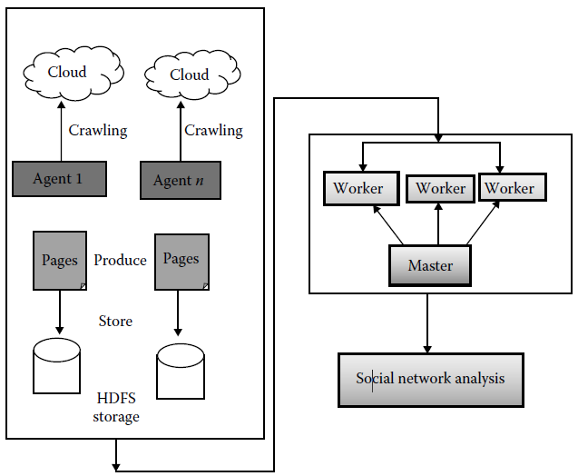
Warehousing and Analyzing Social Data Using Cloud
Process of warehousing and analyzing of social data:
Bina Nusantara University

Slide 12
Warehousing and Analyzing Social Data Using Cloud
Architecture of the social network analysis using cloud:
  Front-end data collection component: gathers social data from various social networking websites using crawling programs. It then stores these data in a distributed environment, e.g. using the Hadoop Distributed File System (HDFS).
  Intermediate system analysis component: the bulk synchronous parallel (BSP) model is used to process social data according to various algorithms based on the master/worker structure.
  Analysis result producing component: produces the final result from the analyzed data. Users can get results according to the required analysis with the help of web interfaces or APIs.
  Two types of methods are used for social network analysis:
  MapReduce and Hama BSP.
Bina Nusantara University

Slide 13
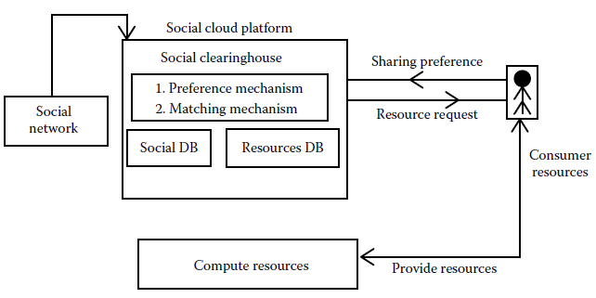
Social Compute Cloud: Sharing and Allocating Resources
Bina Nusantara University

Slide 14
3D Visualization of Social Network Data
A popular data analysis method called online analytical processing (OLAP) can be used to analyze social data.
OLAP is a tool for answering multidimensional analytical problems that encompass data mining and a relational database.
It enables users by analyzing multidimensional data interactively from multiple perspectives.
Bina Nusantara University

Slide 15
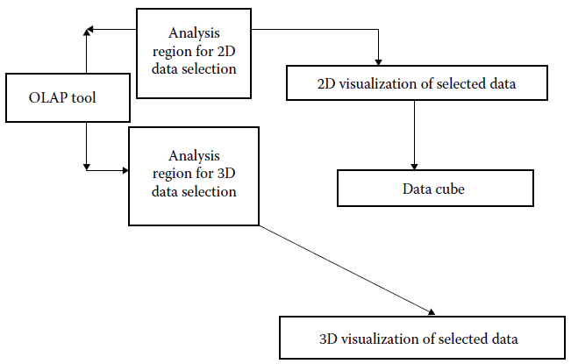
3D Visualization of Social Network Data
OLAP data analysis process:
Bina Nusantara University

Slide 16
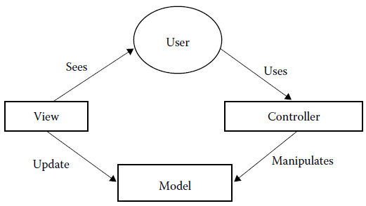
3D Visualization of Social Network Data
3D visualization of large and complex social network data is based on the model view controller (MVC) model.
This model represents and manages the targeted information selected by users from huge social networking data.
Model view controller:
Bina Nusantara University

Slide 17
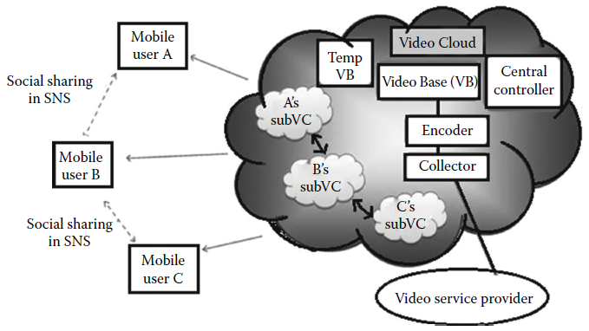
Applications of Mobile Social Cloud
Cloud-Assisted Adaptive Video Streaming
Bina Nusantara University

Slide 18
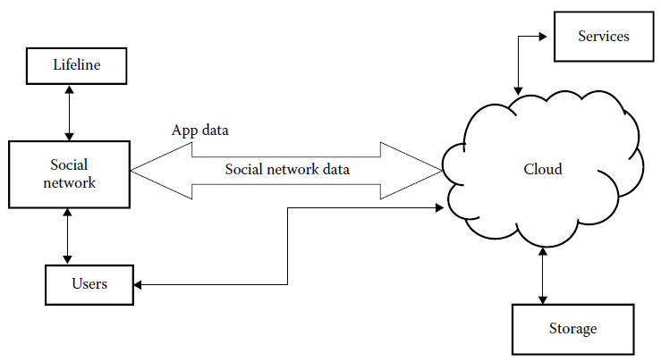
Applications of Mobile Social Cloud
Personal Emergency Preparedness Plan
Bina Nusantara University

Slide 19
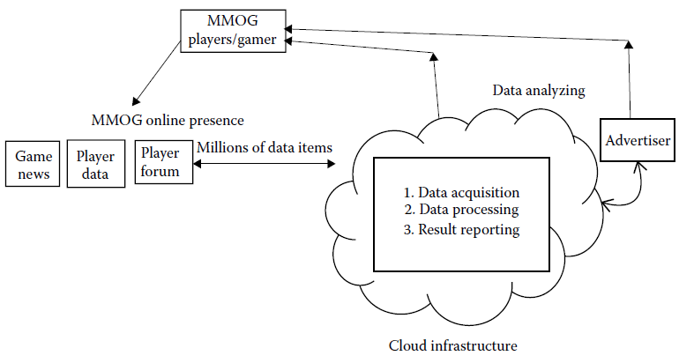
Applications of Mobile Social Cloud
Massively Multiplayer Online Games
Bina Nusantara University

Slide 20
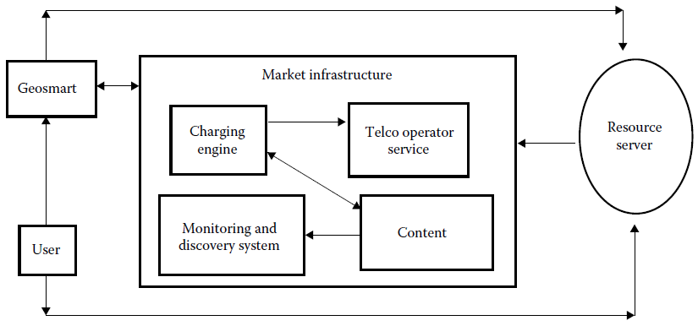
Applications of Mobile Social Cloud
Geosmart: Social Media Education
Bina Nusantara University

Slide 21
Conclusion
The social network platform can be used to gather a huge amount of user data for resource sharing and data analysis.
Facebook, Twitter, online gaming, online video streaming, online TV streaming, and online education systems are using the concept of mobile social cloud computing
The mobile social cloud leverages the existing relationships of people in social networks for service and resource sharing.
Bina Nusantara University

Slide 22
References
Debashis De. (2015). Mobile Cloud Computing: Architectures, Algorithms and Applications. 01. Chapman and Hall/CRC Press. Florida. ISBN: 9781482242836. Taylor & Francis Publishing ISBN- 978–0–203–88776–9
S. R. Yerva, H. Jeung, and K. Aberer, Cloud based social and sensor data fusion, in 15th International Conference on Information Fusion, Singapore, pp. 2494–2501, 2012.
K. Chard, S. Caton, O. Rana, and K. Bubendorfer, Social cloud: Cloud computing in social networks, in IEEE Third International Conference on Cloud Computing, Miami, FL, pp. 99–106, 2010.
K. Chard, K. Bubendorfer, S. Caton, and O. Rana, Social cloud computing: A vision for socially motivated resource sharing, IEEE Transactions on Services Computing, 5(4), 551–563, 2012.
I.-H. Ting, C.-H. Lin, and C.-S. Wang, Constructing a cloud computing based social networks data warehousing and analyzing system, in International Conference on Advances in Social Networks Analysis and Mining, Taiwan, China, pp. 735–740, 2011.
N. Ejaz, I. Mehmood, J. J. Lee, S. M. Ji, M. H. Lee, S. M. Anh, and S. W. Baik, Interactive 3D visualization of social network data using cloud computing, in International Conference on Cloud Computing and Social Networking, Bandung, Indonesia, pp. 1–4, 2012.
Bina Nusantara University

